Slide 1
Static Visualizations of Various Sorting Algorithms
by Aldo Cortesi
http://corte.si/posts/code/visualisingsorting/

Slide 2
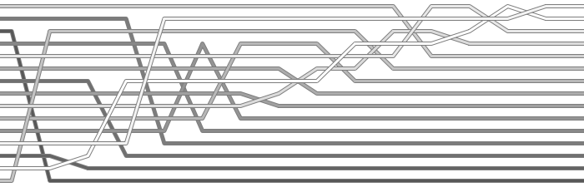
Selection Sort

Slide 3
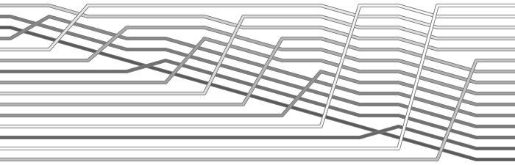
Insertion Sort

Slide 4
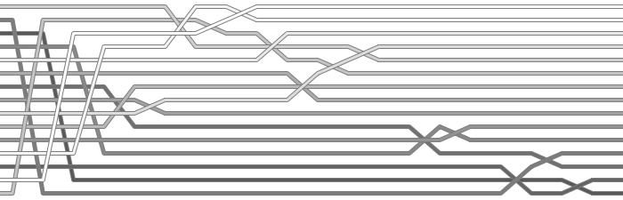
Quicksort

Slide 5
Mergesort

Slide 6
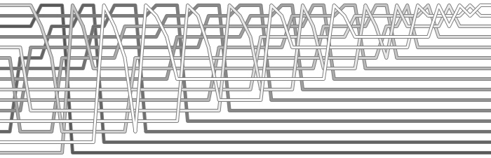
Heapsort

Slide 7
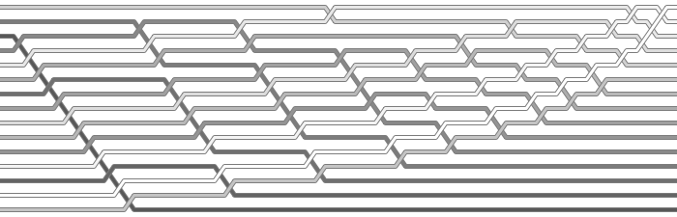
Bubble Sort

Slide 8
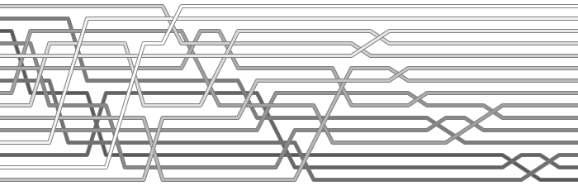
Shell Sort

